Slide 1

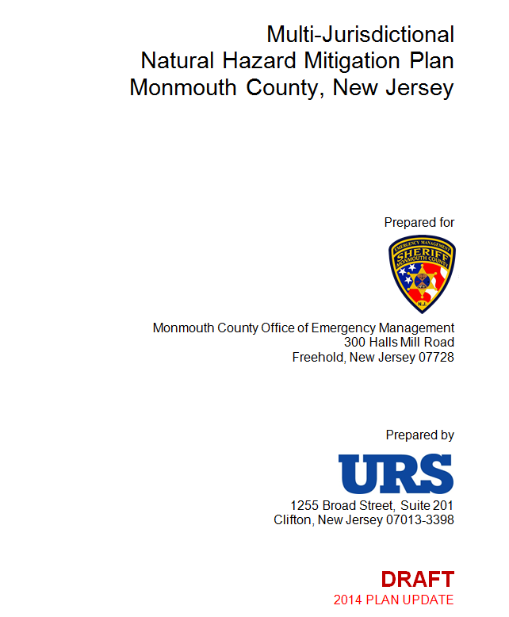
Monmouth County Multi-Jurisdictional
Hazard Mitigation Plan Update
Notes:
(General welcome/introduction)

Slide 2

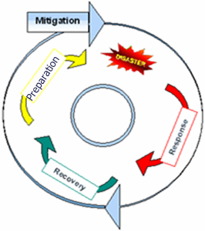
Hazard Mitigation: Breaking the Cycle
Hazard mitigation:
Sustained actions taken to reduce long-term risk to life and property
Natural disasters can’t be prevented, but their impacts can be reduced through hazard mitigation.
Notes:
Natural hazards are a part of life throughout Monmouth County. Some of these hazards can occur anywhere in the County – like thunderstorms, high winds, and winter storms, for example. Others affect only limited areas – things like riverine and coastal flooding, shoreline erosion, and landslides. Regardless of the area they impact, all of these hazards, to different degrees, have the potential to cause property loss, loss of life, economic hardship, and threats to public health and safety. When they occur, some of these hazards don’t disrupt our lives very much - even when they happen regularly. Others, as we’ve all seen with Sandy, can turn the lives of thousands of people upside down. In our communities, an important aspect of emergency management deals with disaster recovery - repairing damages and bringing things back to normal as quickly as possible. An equally important part of emergency management involves hazard mitigation – protecting things before they get damaged, as opposed to repairing things after they get damaged. Hazard mitigation projects are things like elevating buildings in flood hazard areas, installing hurricane clips and storm shutters, relocating critical facilities out of hazard areas, using fire-resistant construction materials in wildfire hazard areas, etc. They can also be more procedural, like changes to local building codes or zoning.

Slide 3
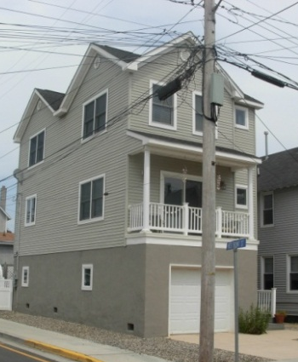
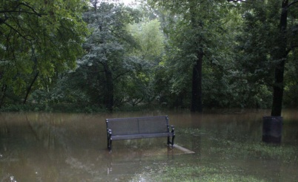
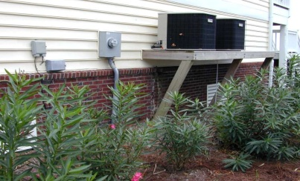

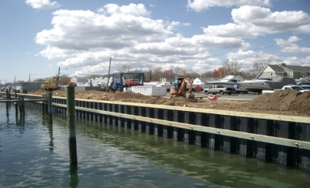
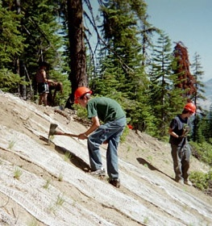
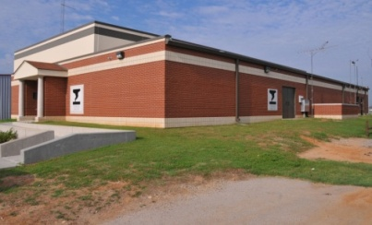
Hazard Mitigation Breaking the Cycle
Elevation of Structures
Property Acquisitions
Elevation of Utilities
Storm Shutters
Flood Reduction
Safe Rooms
Soil Stabilization
Examples:
Notes:
These are some examples of types of activities that are considered “hazard mitigation”.

Slide 4
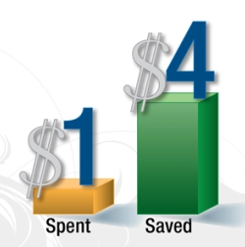
Hazard Mitigation: Breaking the Cycle
According to a study by the Multi-Hazard Mitigation Council (part of the National Institute of Building Sciences):
Every $1 paid toward mitigation saves an average of $4 in future disaster-related costs
Notes:
Hazard mitigation is an important part of a community’s ability to recover from a disaster. According to one study by the Multi-Hazard Mitigation Council (part of the National Institute of Building Sciences), every dollar paid toward hazard mitigation saves an average of $4 in future disaster related costs.

Slide 5
Hazard Mitigation: Breaking the Cycle
Hazard mitigation plans:
Identify the hazards
Describe the risks
Set forth mitigation strategies to reduce key risks
Implementing these mitigation projects will make our community more sustainable and disaster-resilient
Notes:
A hazard mitigation plan describes the hazards that can occur in a community and the risks that these hazards pose, and then presents a list of actions and projects that the community would like to do to reduce these risks. The project list is known as a “mitigation strategy.” Natural disasters cannot be prevented from occurring. But, if we tackle some of the biggest risks with hazard mitigation projects, a little at a time, we can be safer the next time one happens and eventually, the ‘disasters’ won’t have such a big impact on us. A good example of this might be in the case of flooding – if you have four feet of water in a residential area, you have a big problem and people are going to be recovering for months or years afterward. But if you have four feet of water on an empty lot, or in a neighborhood where the homes are elevated, things get back to normal fairly quickly. The flood ends up being less of a ‘disaster’, and more of a nuisance. That’s what the goal is of hazard mitigation, and hazard mitigation planning – to mitigate wherever we can so that our hazards don’t become disasters.

Slide 6
Hazard Mitigation: Breaking the Cycle
Our Multi-Jurisdictional Natural Hazard Mitigation Plan:
Was a requirement to comply with the Disaster Mitigation Act of 2000
Makes jurisdictions and the County eligible to apply for FEMA mitigation project grants
Was approved by FEMA and adopted by jurisdictions in 2009
Notes:
The Multi-Jurisdictional Natural Hazard Mitigation Plan for Monmouth County was prepared between 2007 and 2009 to meet the requirements of the Disaster Mitigation Act of 2000 (or “DMA 2000”). This Act requires all states and local governments to have a hazard mitigation plan in order to be able to apply for certain types of FEMA mitigation project grants. Development of the first plan was led by the County, under a FEMA planning grant that covered the costs of its development. Though it wasn’t required, Monmouth County used what FEMA calls a ‘multi-jurisdictional’ approach for the plan – meaning that instead of it just being a plan for the County government, every municipality was invited to participate as equal partners with the County. This opened the door for all municipalities to be able apply to FEMA for hazard mitigation project grants, including monies that became available under recent Federal disaster declarations for Hurricane Irene, the remnants of Tropical Storm Lee, and of course - Superstorm Sandy.

Slide 7
Hazard Mitigation: Breaking the Cycle
Hazard mitigation plans must be:
Implemented on an ongoing basis (projects)
Revise Annually
Resubmitted for approval every five years
First plan update process is nearing completion:
Draft Plan Update Released October 22, 2014
Comments due by November 18, 2014
Notes:
To stay in compliance with DMA 2000, our plan has to be updated every five years. The update makes sure that the plan remains current in its discussion of what the local risks are, and what the risk reduction strategies are. The first formal plan update process began in 2012. We expect the updated plan to be reapproved by FEMA and adopted by all communities in 2014. The County has once again obtained FEMA grant funding to cover the cost of the plan update, and has opted to continue its ‘multi-jurisdictional’ approach. Each jurisdiction has attended meetings, provided feedback in a series of topic areas, reached out to the public and other key stakeholders, and updated their local mitigation strategy.

Slide 8
Hazard Mitigation: Breaking the Cycle
Hazard mitigation plan updates ensure that the plan:
continues to remain applicable to present-day understanding of vulnerabilities based on most recent studies, reports, event histories, etc; and
continues to present the best path forward for reducing future damages when hazard events occur.

Slide 9
Hazard Mitigation: Breaking the Cycle
Hazard mitigation plan updates:
Revisions to reflect current conditions and the latest reports, studies, and technical information
Assessment of current development patterns and development pressures
Evaluation and incorporation of new hazard or risk information
Progress in local mitigation efforts
Assessment of previous goals and actions
Evaluate progress in implementing actions
Adjust actions to address current trends
Make changes to reflect changes in local priorities

Slide 10
Hazard Mitigation: Breaking the Cycle
Hazard mitigation plan updates:
Each jurisdiction in the county has participated in the first plan update process, 2012-2014
Attended meetings
Conducted outreach
Provided information and feedback
Updated their municipal mitigation action plan
Is reviewing and commenting on the Draft document

Slide 11
Hazard Mitigation: Breaking the Cycle
Hazard mitigation plan updates:
Updated risk assessment
Updated hazard and vulnerability data to reflect recent events; and new data, studies, reports, etc.
Updated NFIP data (new flood maps, latest information on Repetitive Loss Properties, etc.)
Updated to reflect changes in development in hazard prone areas
Quantification of completed projects
Updated plan implementation and monitoring strategy for the next five year cycle

Slide 12
Hazard Mitigation: Breaking the Cycle
Hazard mitigation plan updates:
Update/expand mitigation strategies (action plans) to ensure that they represent a robust strategy for reducing risk
Describe the status of each action in the previous plan:
Completed?
Still relevant?
Will it be included in the udpated action plan (why or why not)
Have any priorities changes? If so, how/why?

Slide 13
Hazard Mitigation: Breaking the Cycle
Additional things considered in this update:
Climate change / sea level rise
HAZUS Level 2
HAZUS is a software package which estimates damages from certain hazard events. Level 1 uses nationwide data primarily from the Census. Level 2 allows for the use of particular parcel data, and therefore provides improved damage estimates

Slide 14
Hazard Mitigation: Breaking the Cycle
Next Steps :
Comments on the Draft Update due 11/18/14
State and Federal agency reviews-ongoing
Incorporation of agency comments
Submittal of a Revised Draft to State and FEMA
State and FEMA deem plan “Approvable Pending Adoption”
Consultants prepare a Final version of the document
Each jurisdiction will pass a resolution to formally adopt the plan and commit to implementing the mitigation actions and projects within it
When FEMA receives the adoption resolution, the plan is considered to be approved and “in place” for that community
Notes:
.

Slide 15

For More Information / To Become Involved
MCOEM
Michael Oppegaard
Coordinator
moppegaard@mcsonj.org
732-431-7400
Margaret Murnane Brooks
Deputy Coordinator
mmurnane@mcsonj.org
732-431-7400
www.mcsonj.org/Sections-read-144.html
Notes:
For questions or other feedback, or to find out how you can become involved, please contact your community’s local elected official or Emergency Management Coordinator. At the County level, please feel free to reach out to Michael E. Oppegaard, Coordinator, Monmouth County Sheriff’s Office, Emergency Management Division (phone: 732-431-7400; e-mail: moppegaard@mcsonj.org) or his Deputy Coordinator, Margaret Murnane-Brooks (phone: 732-431-7400; e-mail: mmurnane@mcsonj.org). More information about the project is maintained on the County Sheriff’s Office web site at: www.mcsonj.org/Sections-read-144.html

